Slide 1
Signalized Intersection
Delay Monitoring for
Signal Retiming
SafeTrip-21
Safe and Efficient Travel
through Innovation and Partnership
in the 21st Century
Sudhir Murthy, PE, PTOE
President
TrafInfo Communications, Inc.
Lexington, MA

Slide 2
Presentation Outline
System Objectives
Methodology
Technology
Test Site
  Equipment Installation
  Data Collected
Results
Concluding Remarks

Slide 3
System Objectives
To monitor traffic operations at a signalized intersection in real-time (cycle-by-cycle) by:
  Collecting traffic signal timing and volume data
  Estimating control delay using procedure within the 2000 Highway Capacity Manual (HCM)
To develop a cost-effective system to
  Identify signalized intersections in need of improvements (ex. Re-timing)
  Allow remote download of new signal timing
  Assess the benefits resulting from it

Slide 4




Methodology
HCM Control Delay
where
d₁ = uniform delay
d₂ = incremental delay
d₃ = initial queue delay
g = effective green (sec)
C = cycle length (sec)
v = volume
S = saturation flow rate
PF = Progression Adjustment Factor
(Exhibit 16-12 using Arrival Type)
Directly measured
Estimated from
Directly measured
Headway & Occupancy
k = Incremental delay factor
(Exhibit 16-13)
I = Upstream filtering factor
(assumed = 1.0)
HCM Procedure

Slide 5
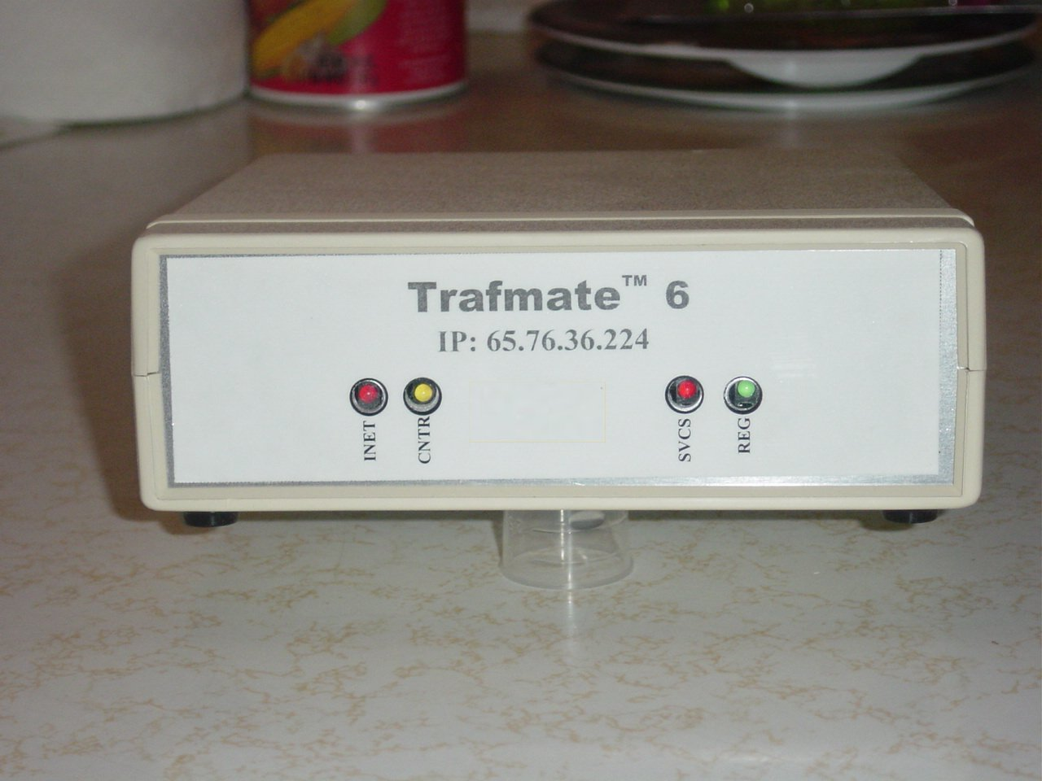
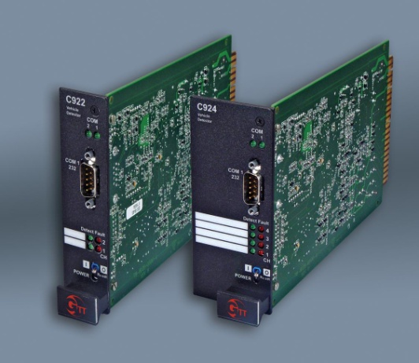
Technology
Trafmate™ 6
Integrated C-programmable micro-controller with dual serial port and wireless PCS cellular modem
GTT Canoga ™ Loop Detector
Traditional loop detector with count capability (including “long loop”) and a front panel serial port

Slide 6
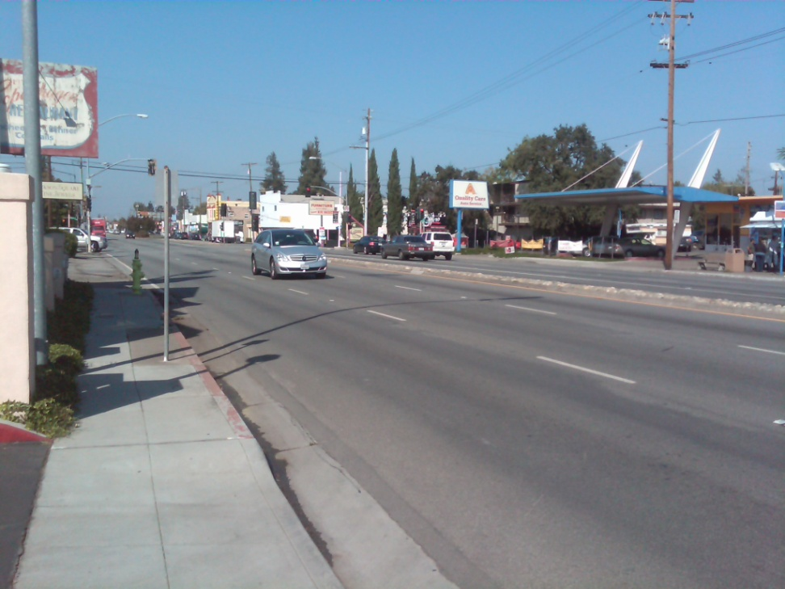
Test Site
El Camino Real
at Dumbarton Rd/Oakland St
Redwood City, CA
Φ4
N
Φ2
Φ1
Φ5
Φ6
Φ4

Slide 7
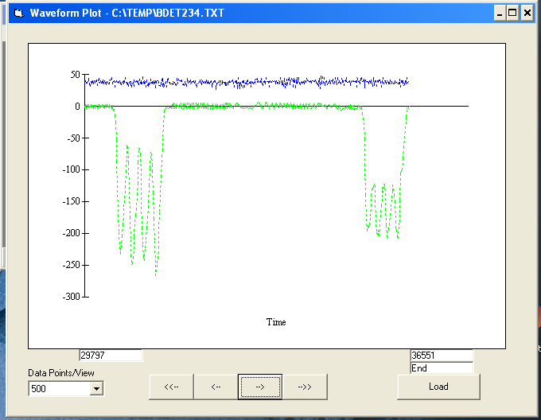
Test Site Assessment
Thorough assessment of each loop in terms of inductance waveforms
Calibration of Canoga loop detector parameters for “long-loop” counting

Slide 8
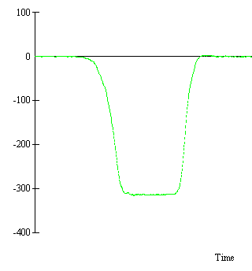
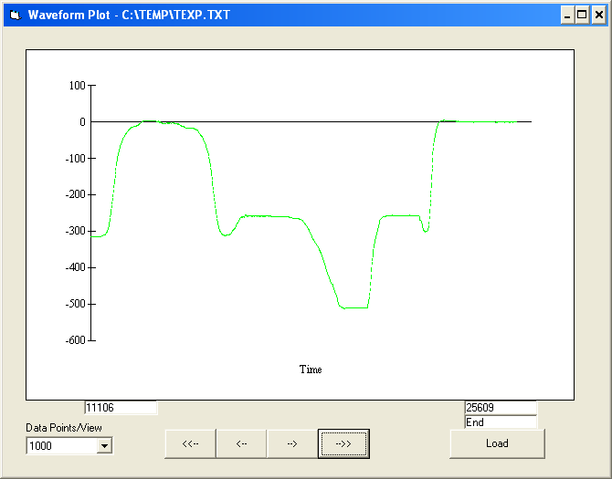
Long Loop Detection Technology
Car 1
Car 2

Slide 9
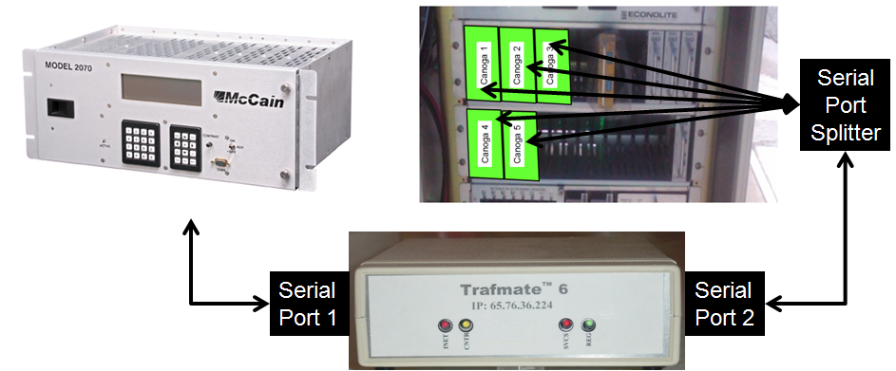
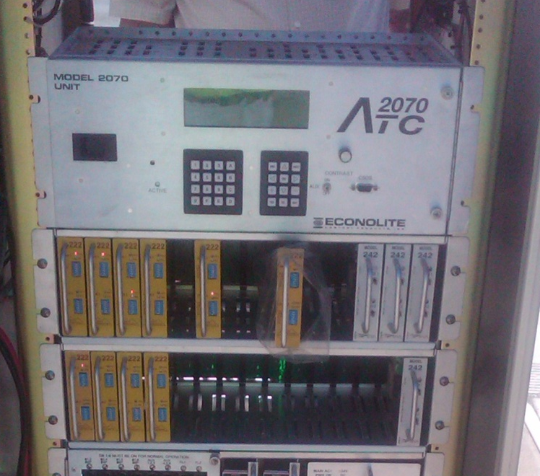
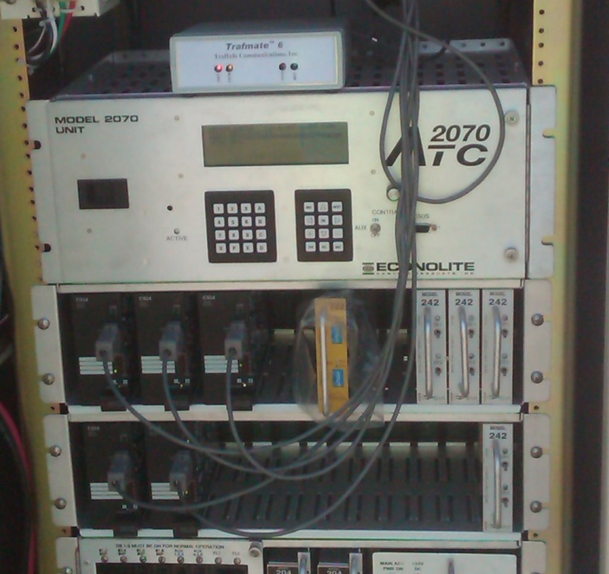
Test Site Installation
Signal
Timing
Traffic
Volume
BEFORE
AFTER

Slide 10
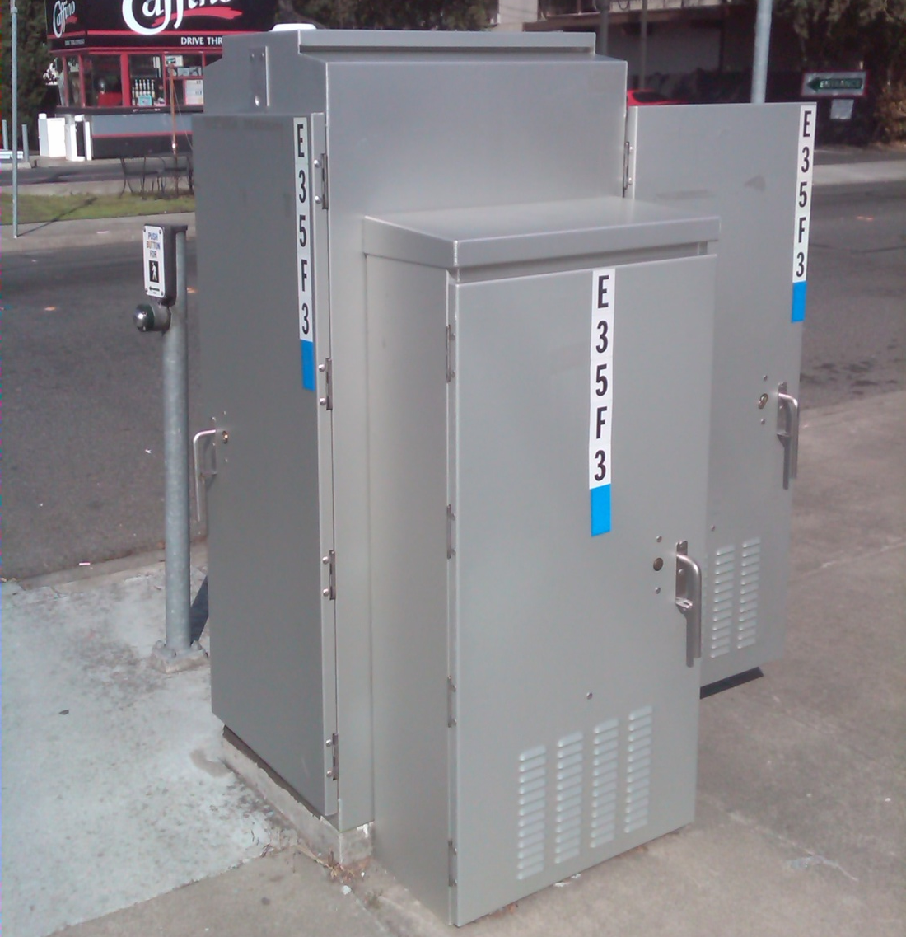
Data Collected
MySQL®
Database
Signal Timing
  Total cycle length
  Green time of each phase
Traffic Volume
  Time to service first vehicle in queue
  Volume during green & clearance
  Total occupancy during green
  Average headway (from 3rd to 10th vehicle)
Central
Server
Software
Wireless
Internet
Web-Interface
Control Delay
User

Slide 11
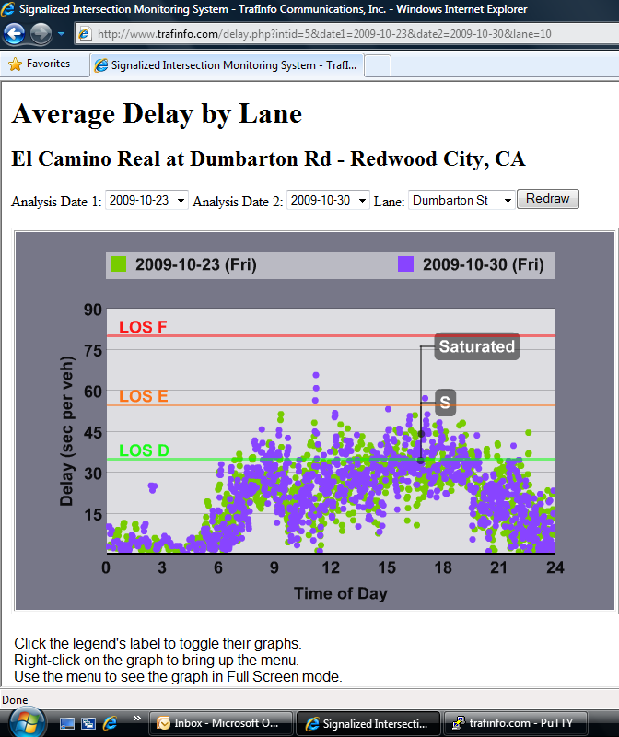
Results - Control Delay
Southbound Through Lane 1
Northbound Exclusive Left Lane

Slide 12
Unique Aspects of System
Estimation of Saturation Flow Rate of each cycle from headway measurements
Estimation of Arrival Type using occupancy and volume measurements

Slide 13



Direct Field Measurement of SFR
11
10
9
8
7
6
5
4
3
2
1
12
11
10
9
8
7
6
5
4
3
2
1
12
11
10
9
8
7
6
5
4
3
Headway measurements

Slide 14
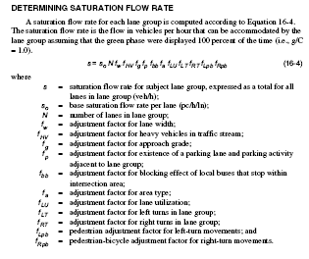
HCM Saturation Flow Rate Calcs

Slide 15
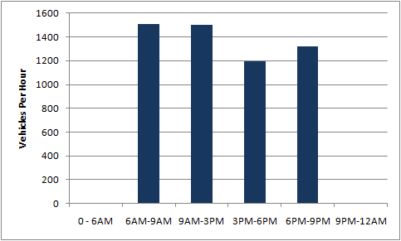
Project Results – Saturation Flow Rate
Default: Values computed using HCM
Default: Values computed using HCM
Estimated based upon headway – SB Thru Lane 1

Slide 16
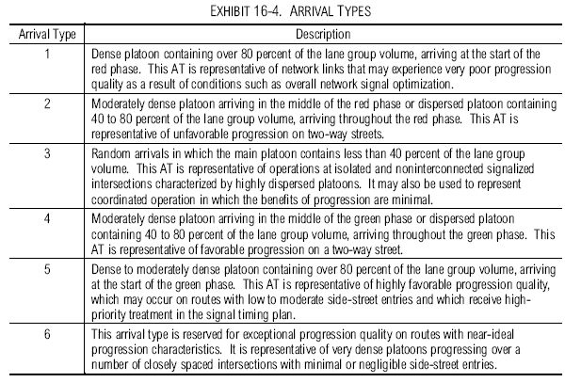
HCM Arrival Types

Slide 17
Occupancy-Arrival Type Relationship
100%
Actual
Field
Measurement
Estimated
Occupancy
0%
1
2
3
4
5
6
Arrival Type

Slide 18
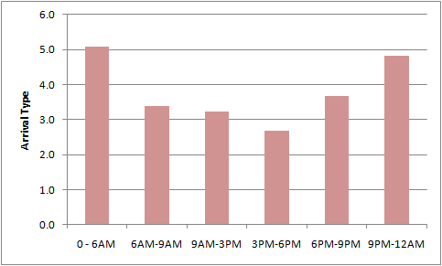
Project Results - Arrival Type
Estimated based upon occupancy and volume – SB Thru Lane 1

Slide 19
Steps to Retime Signals
Collect data for 2-3 days and evaluate data to determine need for signal timing
Use volume information to determine optimal signal timing (ex. Synchro, etc)
Upload new signal timing to controller via the wireless modem
Continue to collect data for another 2-3 days and evaluate data.
Repeat steps if necessary or document improvements.

Slide 20
Concluding Remarks
Demonstrates a cost-effective method for signalized intersection traffic monitoring
Next Steps:
  Additional reporting capability (ex. Peak hour)
  Real-time adjustments to saturation flow rate and arrival types
Future Challenges:
  Variety of detection systems for signal control
  Data accuracy of detection systems

